Slide 1
True Black-Box Explanation in Facial Analysis
CVPR 2022 Biometrics Workshop
New Orleans, June 19, 2022
Domingo Mery
Department of Computer Science
Universidad Católica – Chile
http://domingomery.ing.uc.cl

Slide 2
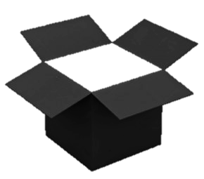
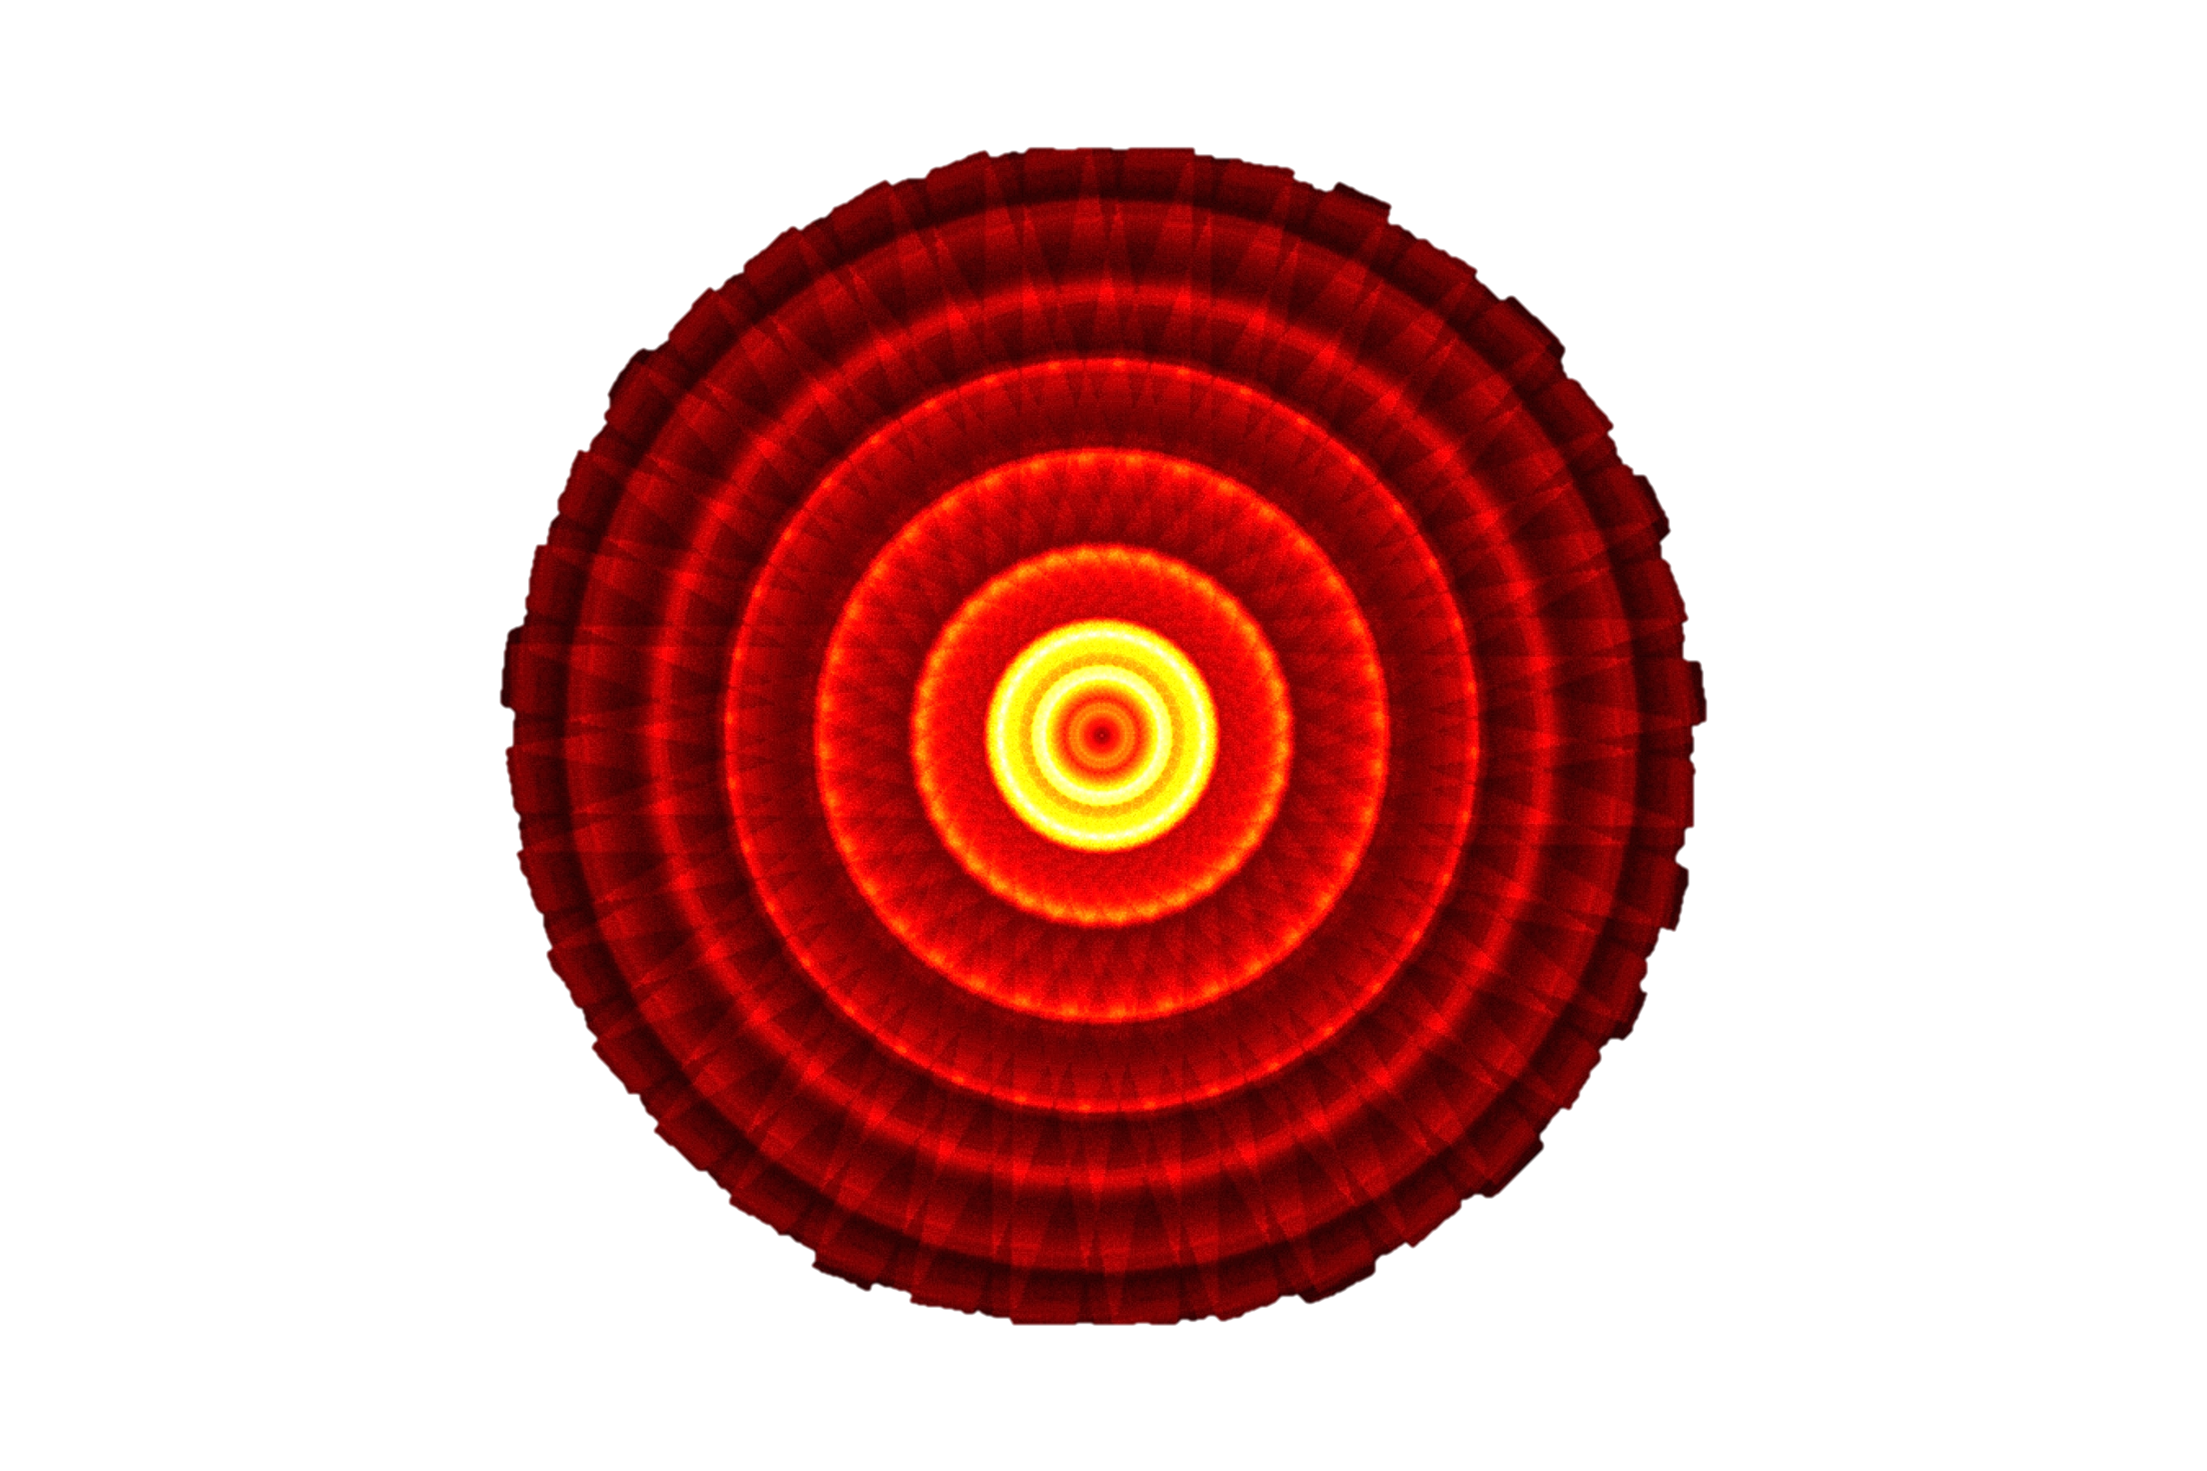
True Black-Box Explanation in Facial Analysis
CVPR 2022 Biometrics Workshop
New Orleans, June 19, 2022
Domingo Mery
Department of Computer Science
Universidad Católica – Chile
http://domingomery.ing.uc.cl

Slide 3
4. Conclusions
3. Experiments
2. Method
1. Motivation

Slide 4
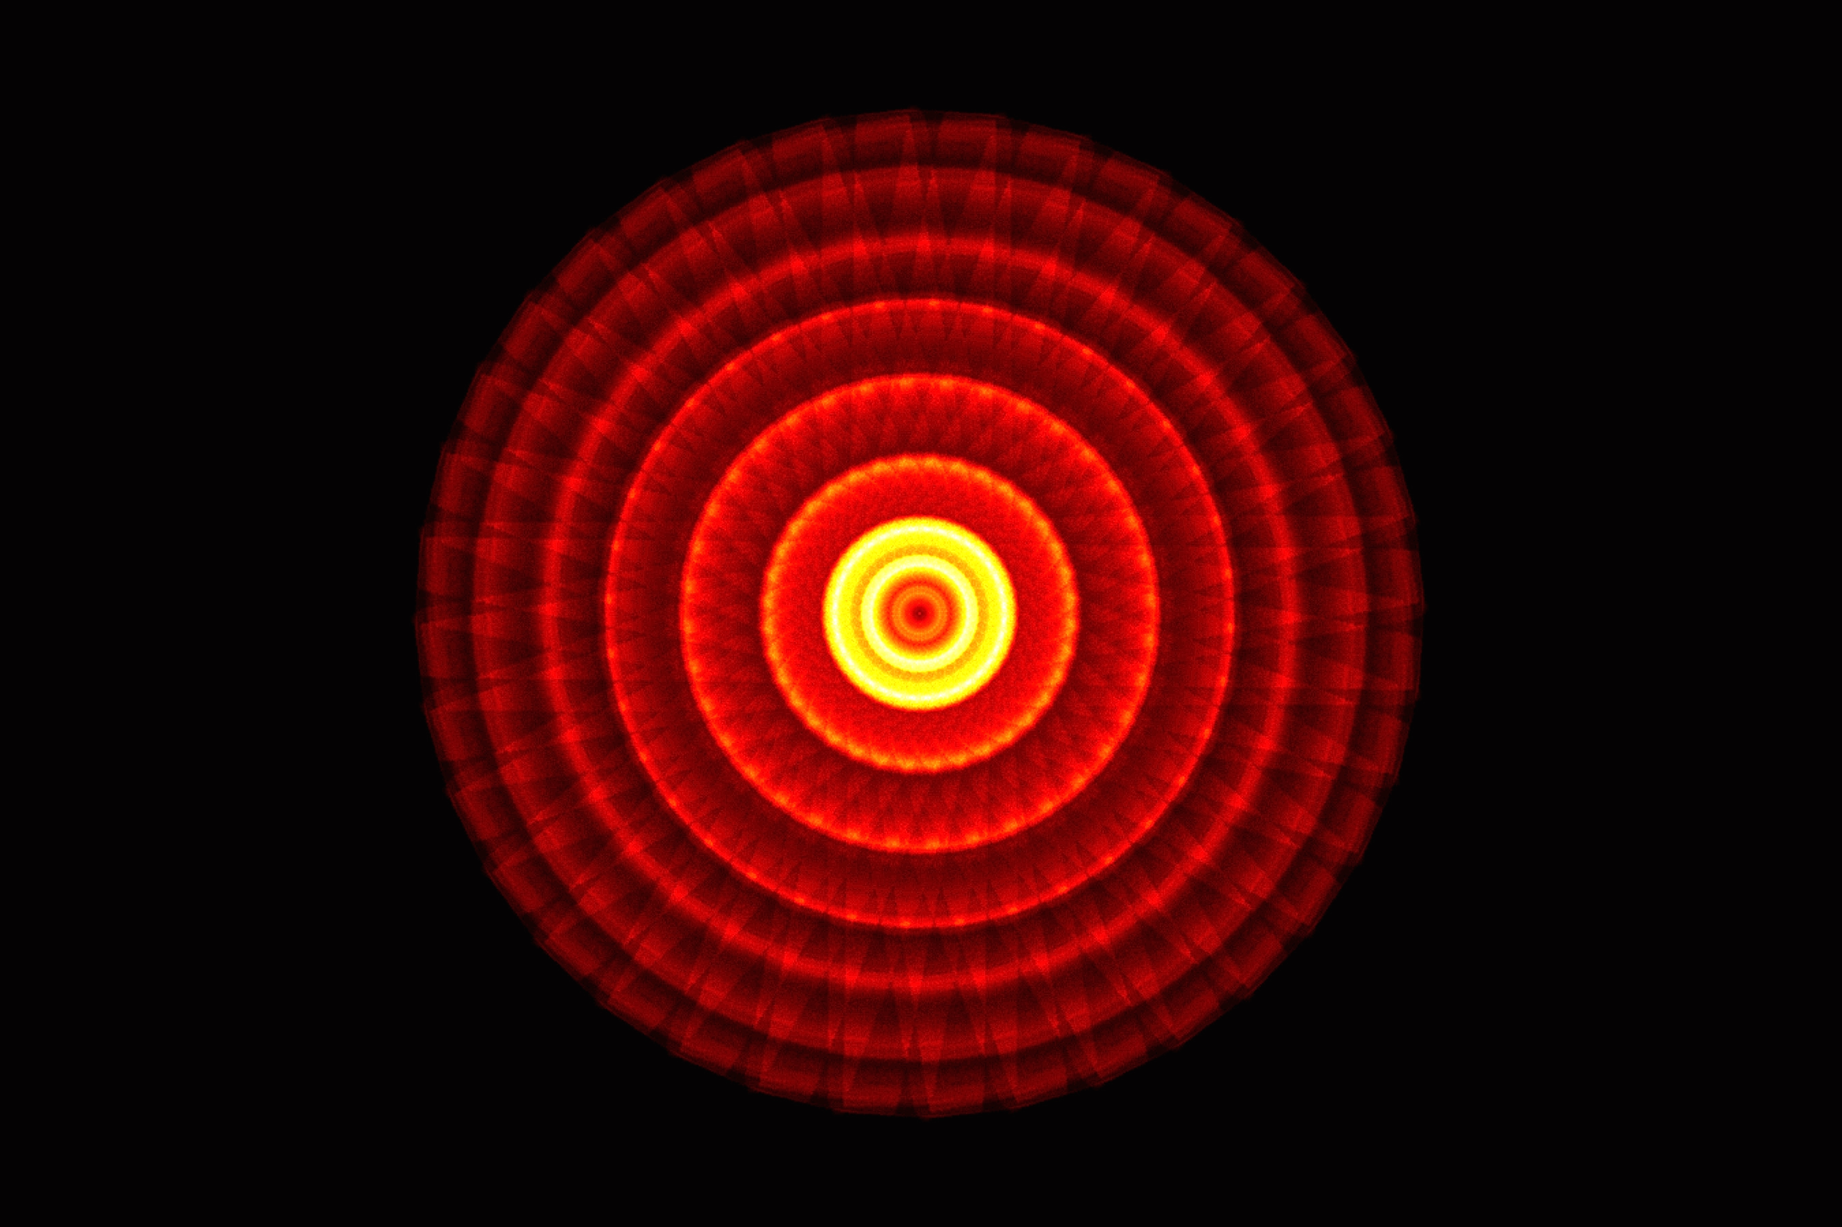
4. Conclusions
3. Experiments
2. Method
1. Motivation

Slide 5
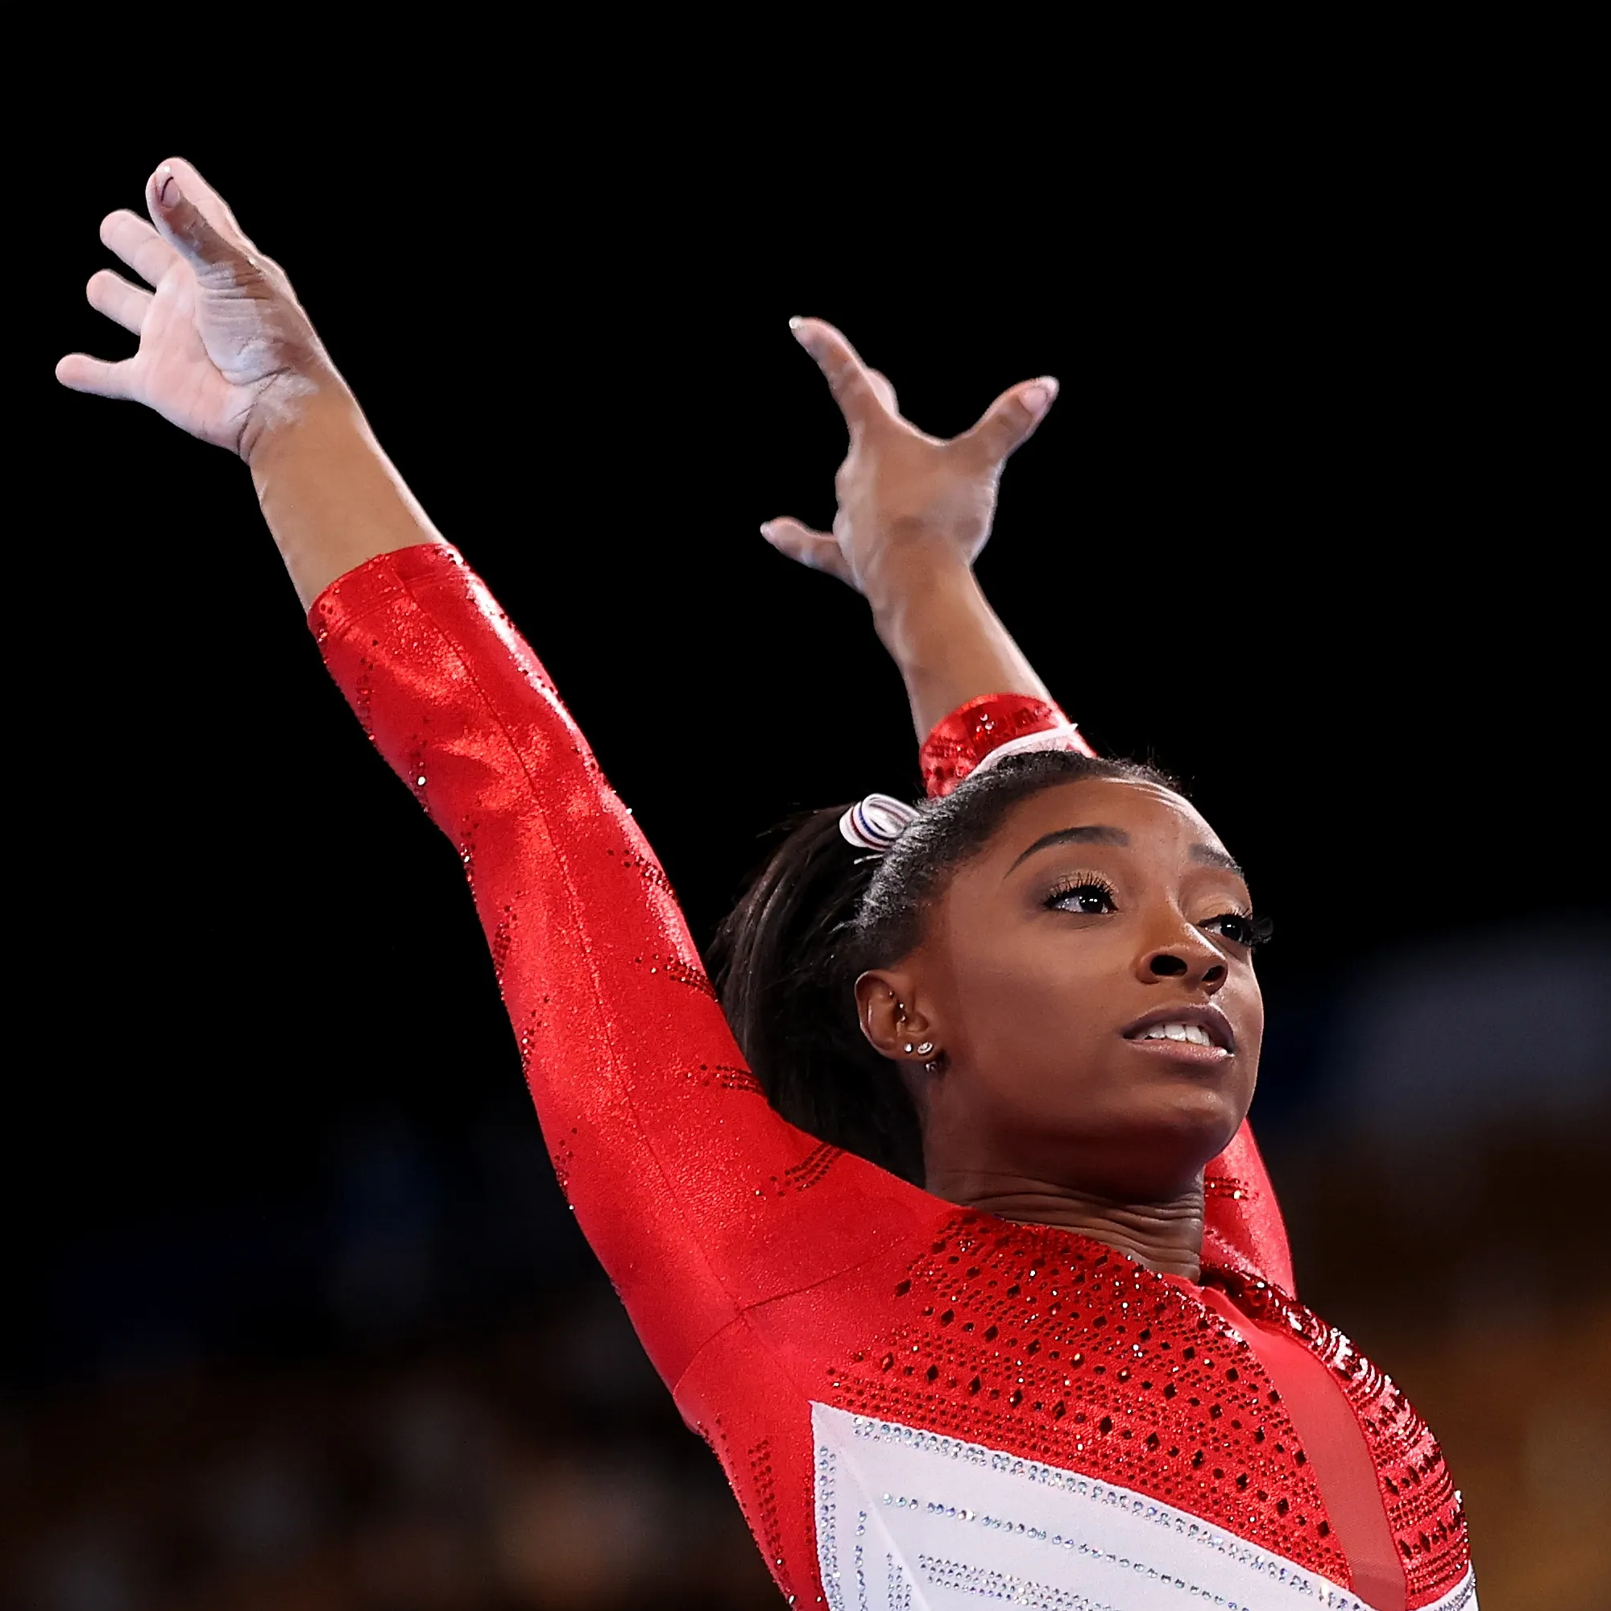
Motivation
Facial
Analysis
Output
input
image

Slide 6
Motivation – Face Detection
Output
Face
Detection
input
image

Slide 7
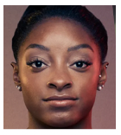
Motivation – Face Verification
enrolled
image
Face
Verification
Output:
Same person
input
image

Slide 8
Motivation – Face Expression
Output:
angry | 0.02
disgust | 0.12
scared | 0.67
happy | 0.01
sad | 0.02
surprised | 0.07
neutral | 0.09
Face
Expression
input
image

Slide 9
Motivation
Facial
Analysis
Output
input
image

Slide 10
Motivation
Facial analysis models are very effective, but it is not known what they do internally, sacrificing interpretability for accuracy.
Explainable facial analysis arises from the need to understand the learned models.
The proposed methodology can help us to interpret and visualize the models that are often considered as black-boxes.
In explainable face analysis, the task is to answer how relevant are the parts of a face image in a recognition problem.

Slide 11
Motivation
f_{x}
Output
input
image
BLACK-BOX

Slide 12
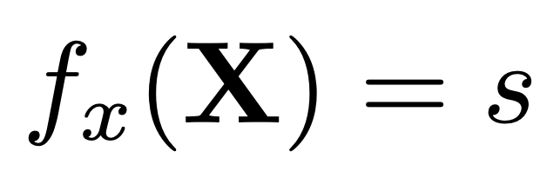
Motivation
BLACK-BOX
(model)
IMAGE
(input)
SCORE
(output)
f_{x}
X
s

Slide 13
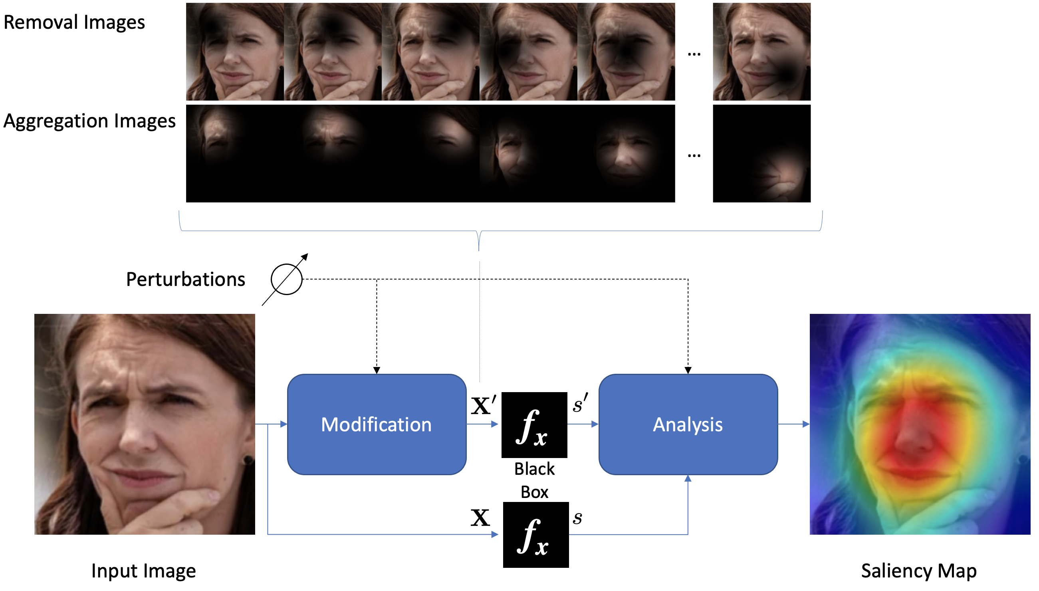
Key idea of the proposed method

Slide 15
Minus
MinPlus
Plus

Slide 16
4. Conclusions
3. Experiments
2. Method
1. Motivation

Slide 17

The proposed method will be explained using an Example:
Saliency map for a `Happiness’ model

Slide 18
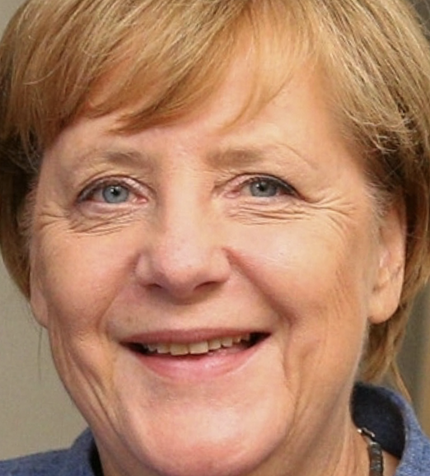
Expression: How `happy´ is this person?
Output:
angry | 0.0001
disgust | 0.0000
scared | 0.0005
happy | 0.9723
sad | 0.0026
surprised | 0.0001
neutral | 0.0245
Face
Expression

Slide 19
Expression: How `happy´ is this person?
Output:
angry | 0.0001
disgust | 0.0000
scared | 0.0005
happy | 0.9723
sad | 0.0026
surprised | 0.0001
neutral | 0.0245
f_{x}

Slide 20
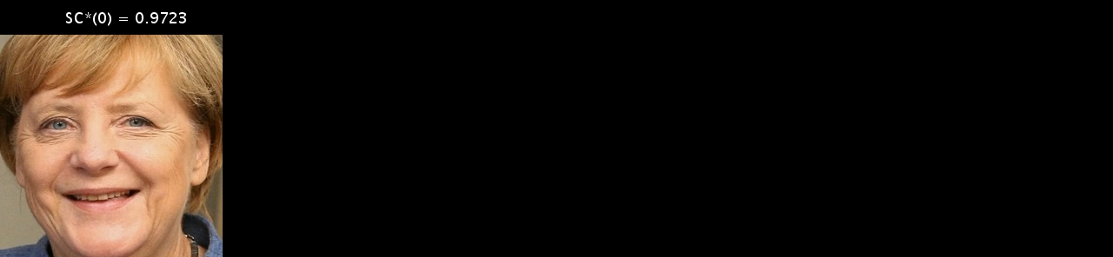
Minus:
Single Approach ( H₀– )
H₀–

Slide 21
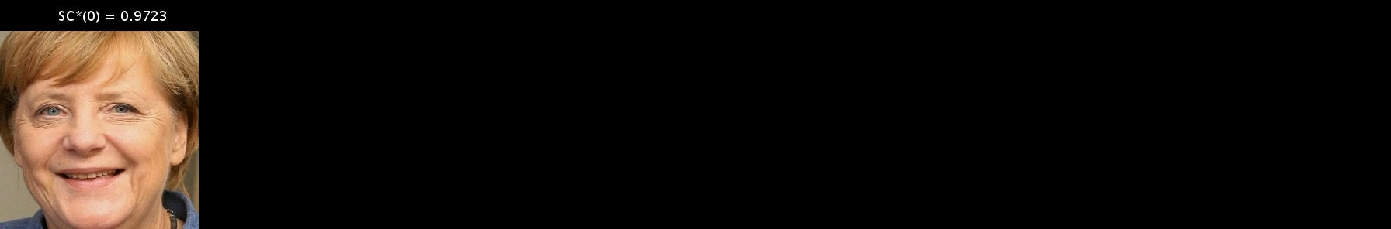
Minus:
Accumulated Approach ( H₁– )
H₁–

Slide 22

Plus:
Single Approach ( H₀+ )
H₀+

Slide 23

Plus:
Accumulated Approach ( H₁+ )
H₁+

Slide 25
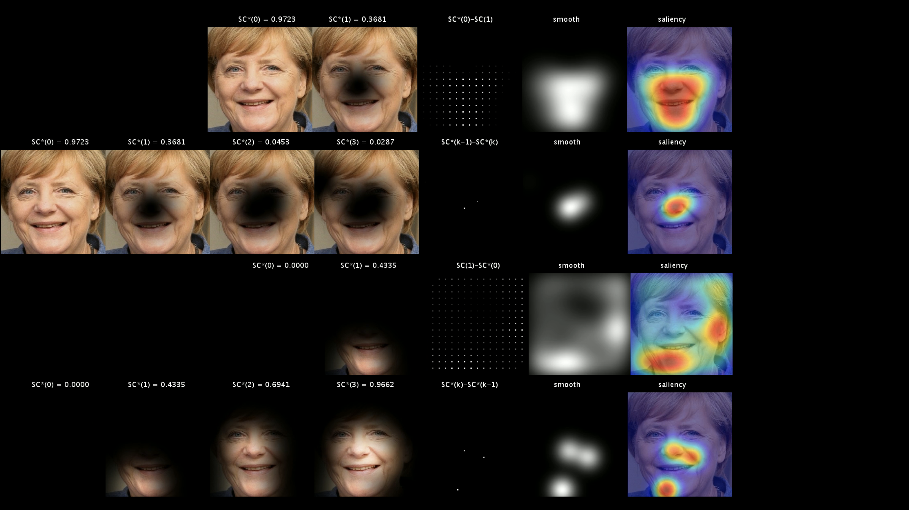
H₀–
H₁–
H₀+
H₁+

Slide 26
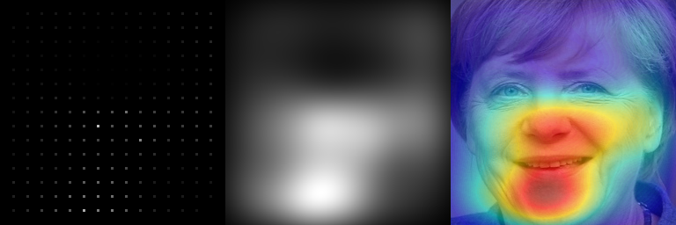
H₀–
H₁–
mean
H₀+
H₁+

Slide 27
H₀–
H₁–
mean smooth
H₀+
H₁+

Slide 28
H₀–
H₁–
mean smooth saliency
H₀+
MinPlus
H₁+

Slide 29
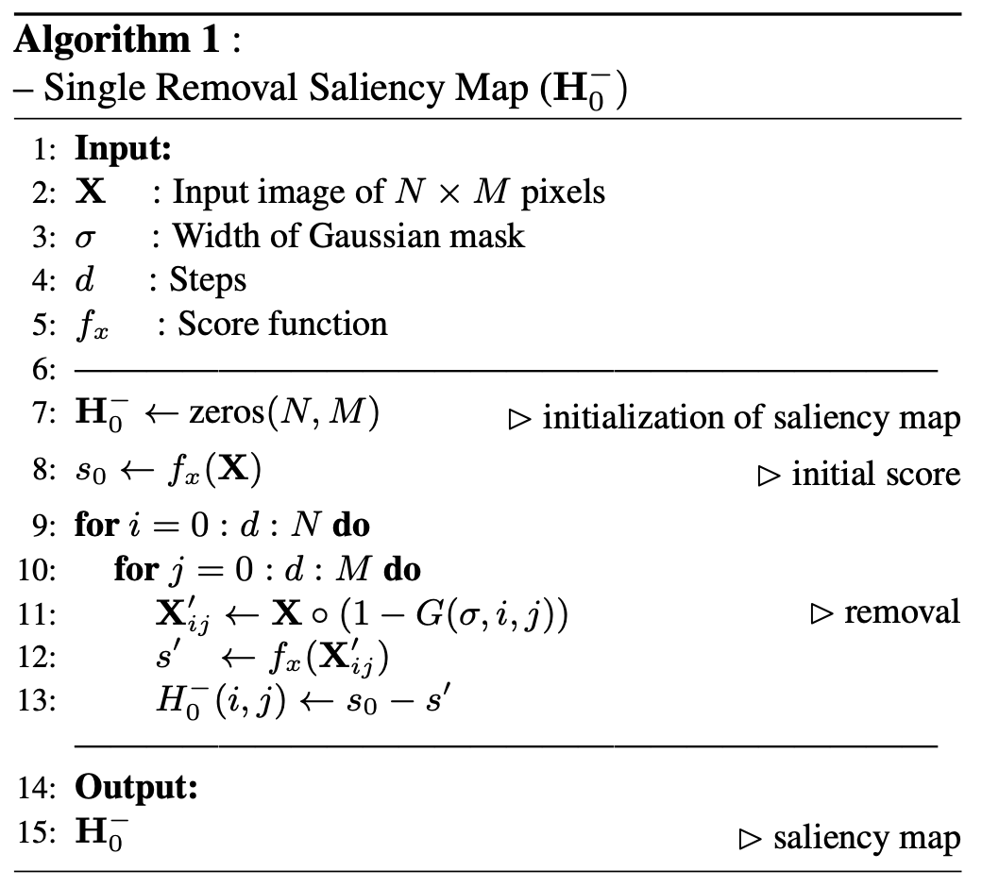
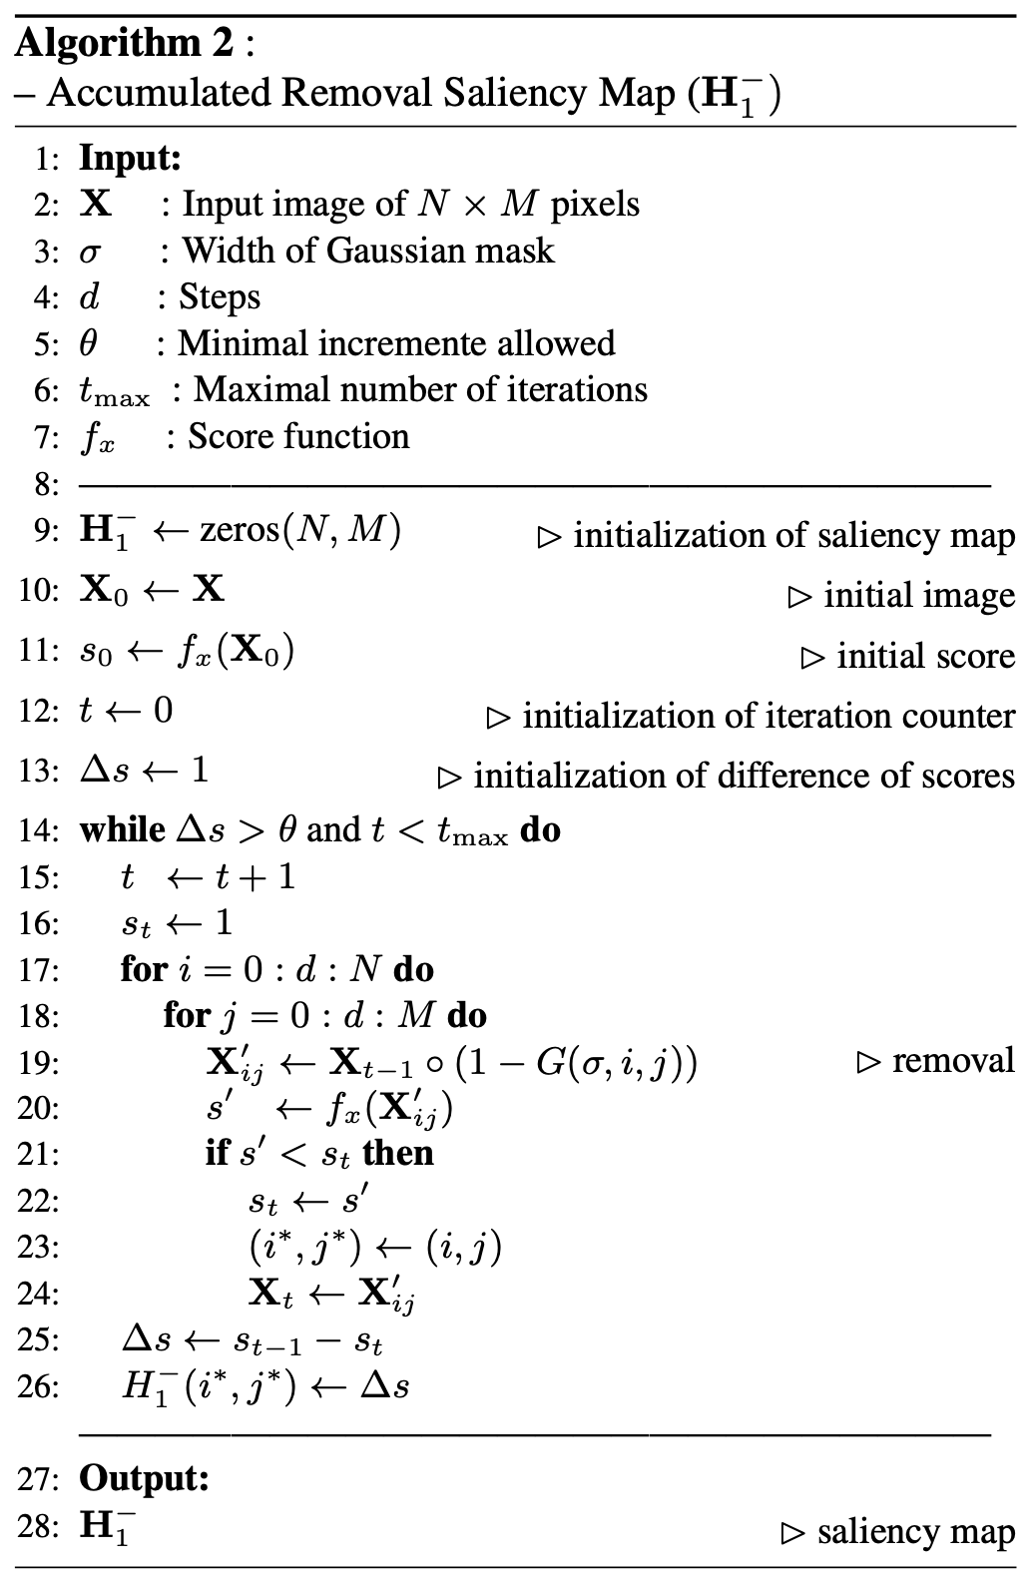
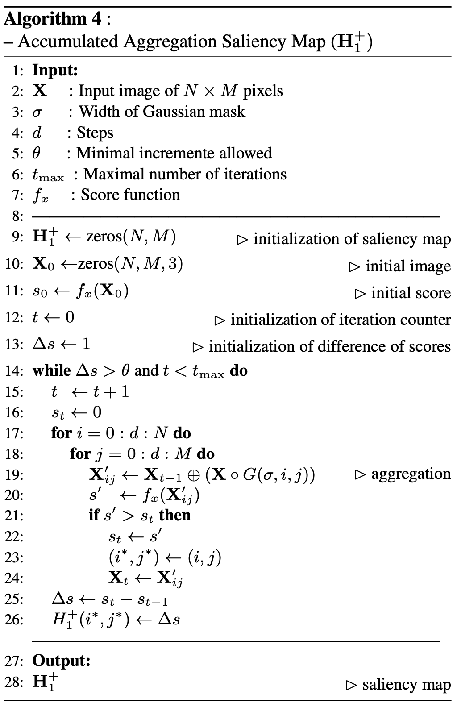
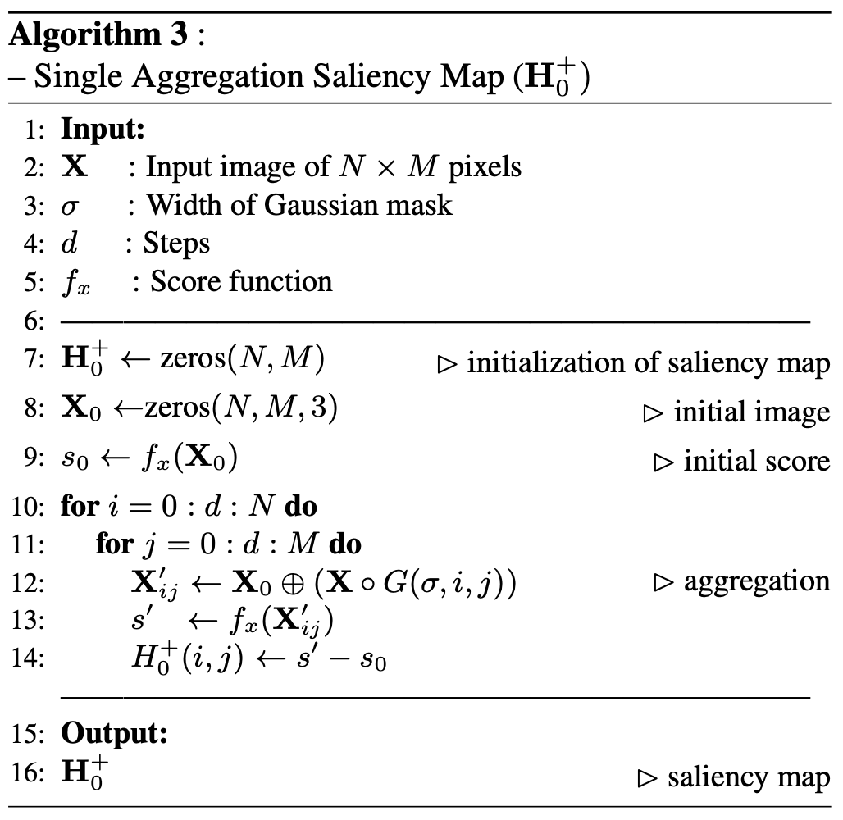
H₀–
H₁–
H₁+
H₀+
See details in the paper…

Slide 30
Explanation: Relevant parts of the model for happiness
MinPlus
H₀–
H₀+
H₁–
H₁+

Slide 31
4. Conclusions
3. Experiments
2. Method
1. Motivation

Slide 32
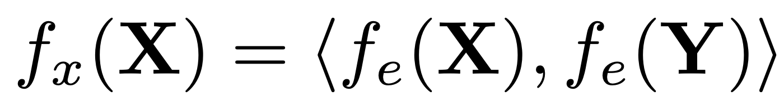
Face Verification
EMBEDDING
PROBE IMAGE
EMBEDDING
GALLERY IMAGE
SCORE
DOT PRODUCT
(cosine distance)

Slide 33


Face Verification
EMBEDDING
PROBE IMAGE
EMBEDDING
GALLERY IMAGE
= 0.8724
SCORE
DOT PRODUCT
(cosine distance)

Slide 34
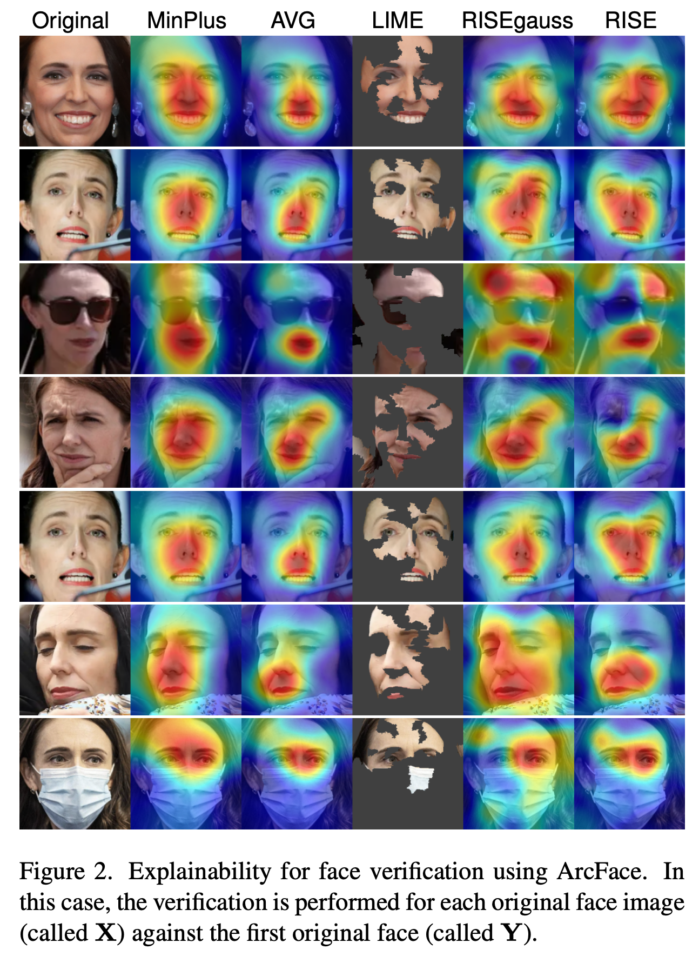
Comparison with
other approaches
Using ArcFace

Slide 35
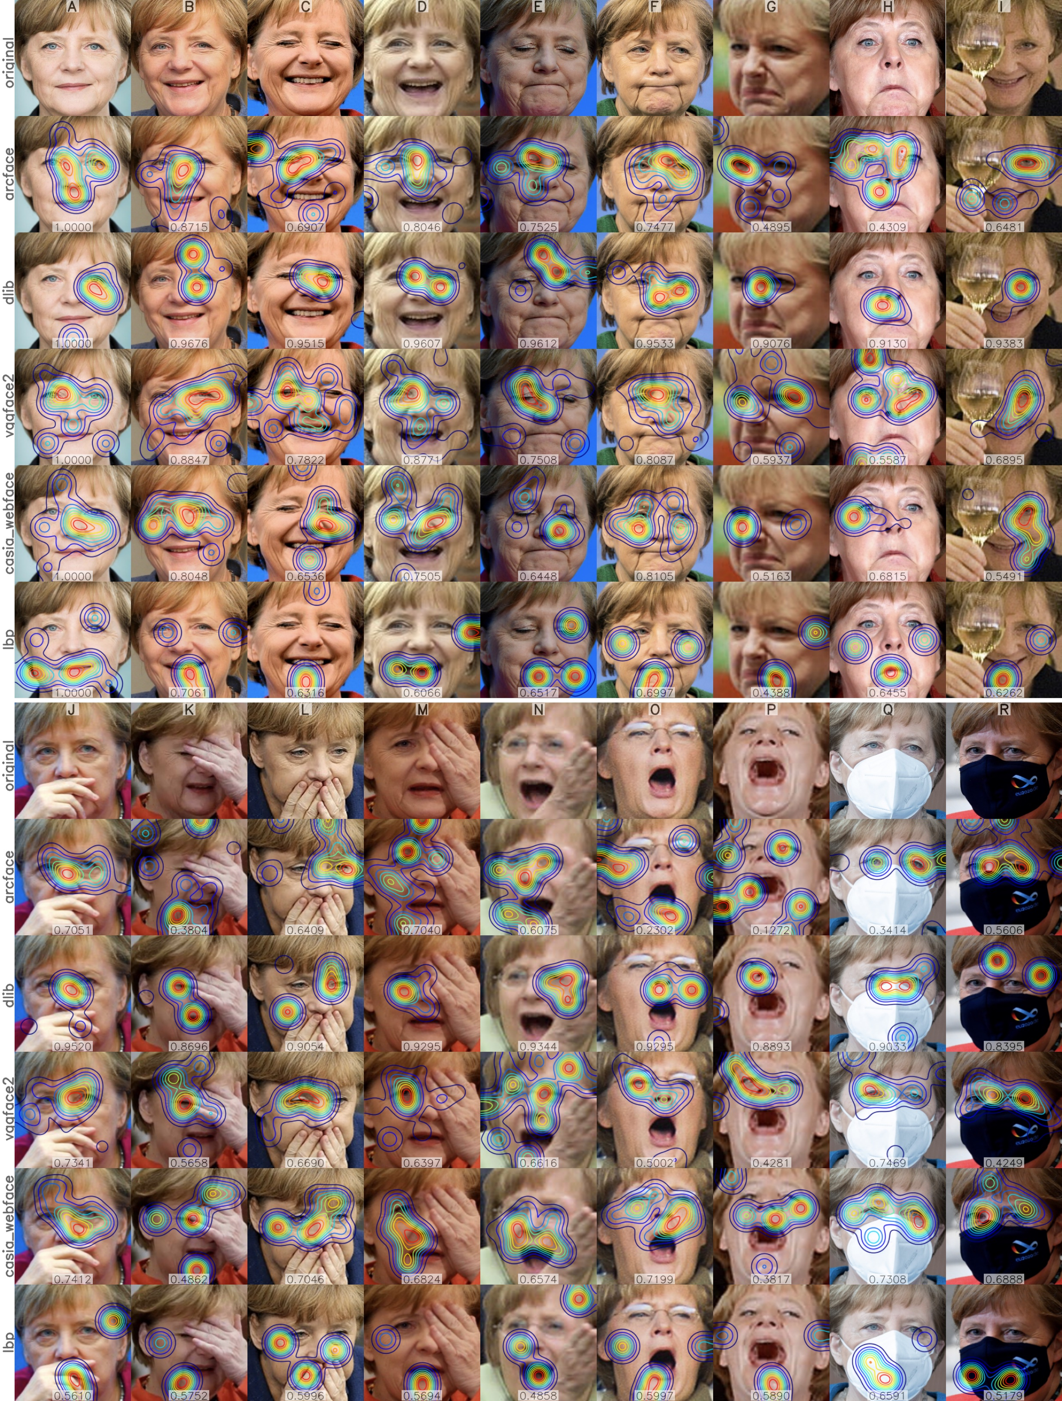
Real face images with different facial expressions, poses, and occlusions for different matchers

Slide 36
Real face images with different facial expressions, poses, and occlusions for different matchers

Slide 37
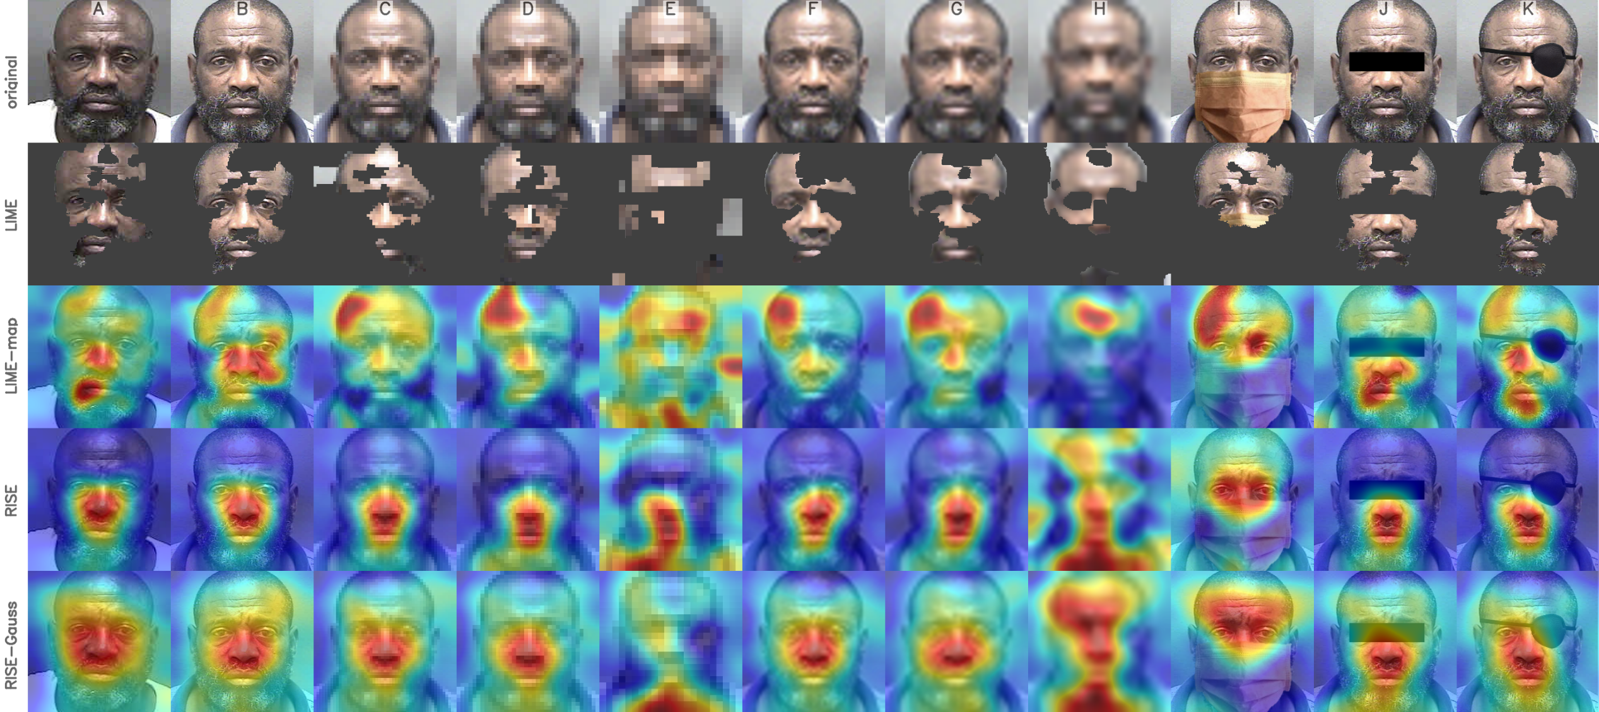
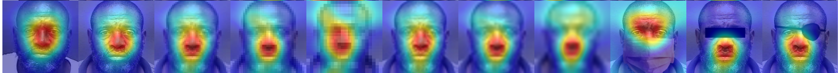
Synthetic images with different qualities and occlusions
MinPlus

Slide 38
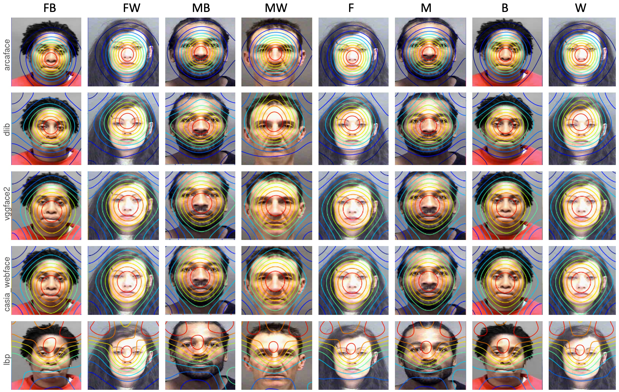
3.
Faces from different demographic groups

Slide 39
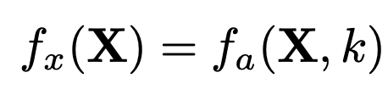
Face Expression (Attribute)
SCORE
ATTRIBUTE
FUNCTION
ATTRIBUTE
NUMBER

Slide 40
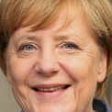
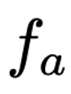
Face Expression (Attribute)
4
= 0.9723
SCORE
ATTRIBUTE
FUNCTION
ATTRIBUTE
NUMBER
angry | 0.0001
disgust | 0.0000
scared | 0.0005
happy | 0.9723
sad | 0.0026
surprised | 0.0001
neutral | 0.0245
SCORE = FOURTH ATTRIBUTE

Slide 41
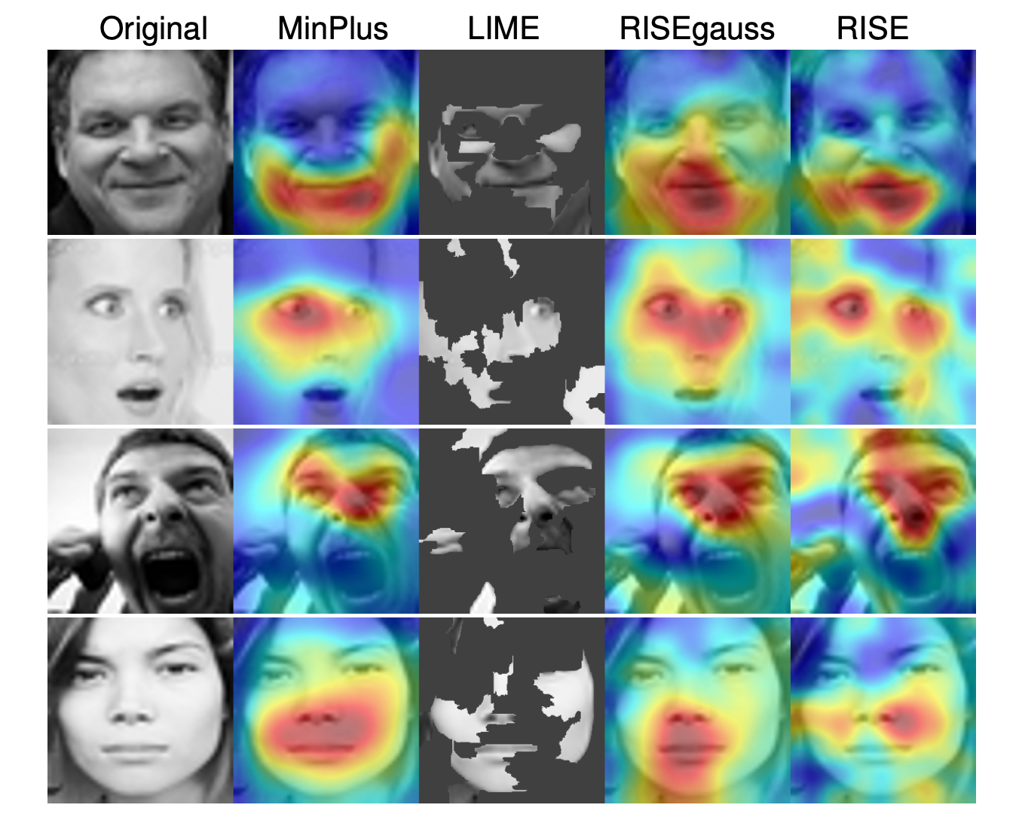
HAPPINESS
Saliency Maps for recognition of expressions using Xception
SURPREISE
ANGRY
NEUTRAL

Slide 42
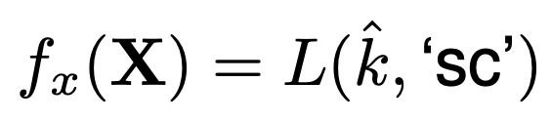
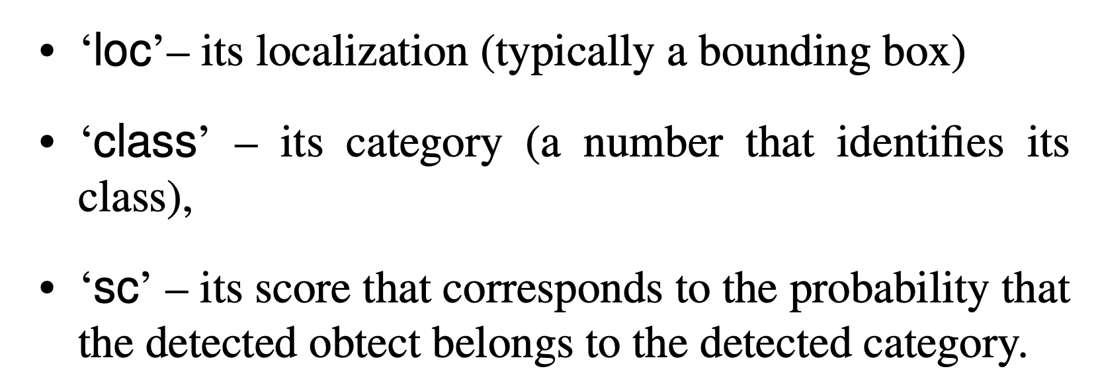
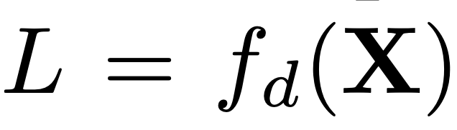
Detection
NUMBER OF THE
DETECTED OBJECT
SCORE
SCORE
LIST OF
DETECTED OBJECTS
FOR EACH DETECTED OBJECT:

Slide 43

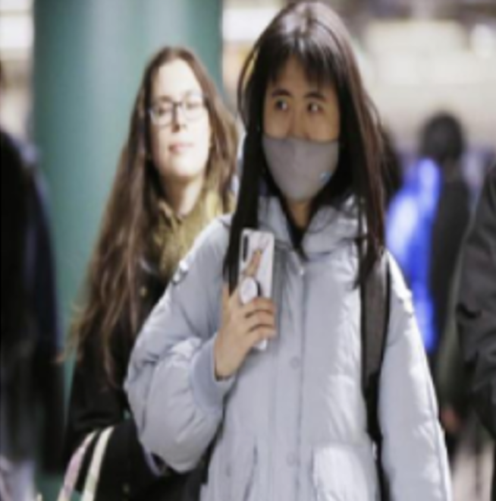
Detection
NUMBER OF THE
DETECTED OBJECT
2
SCORE
= 0.7248
SCORE
LIST OF
DETECTED OBJECTS
FOR EACH DETECTED OBJECT:
1
2

Slide 44
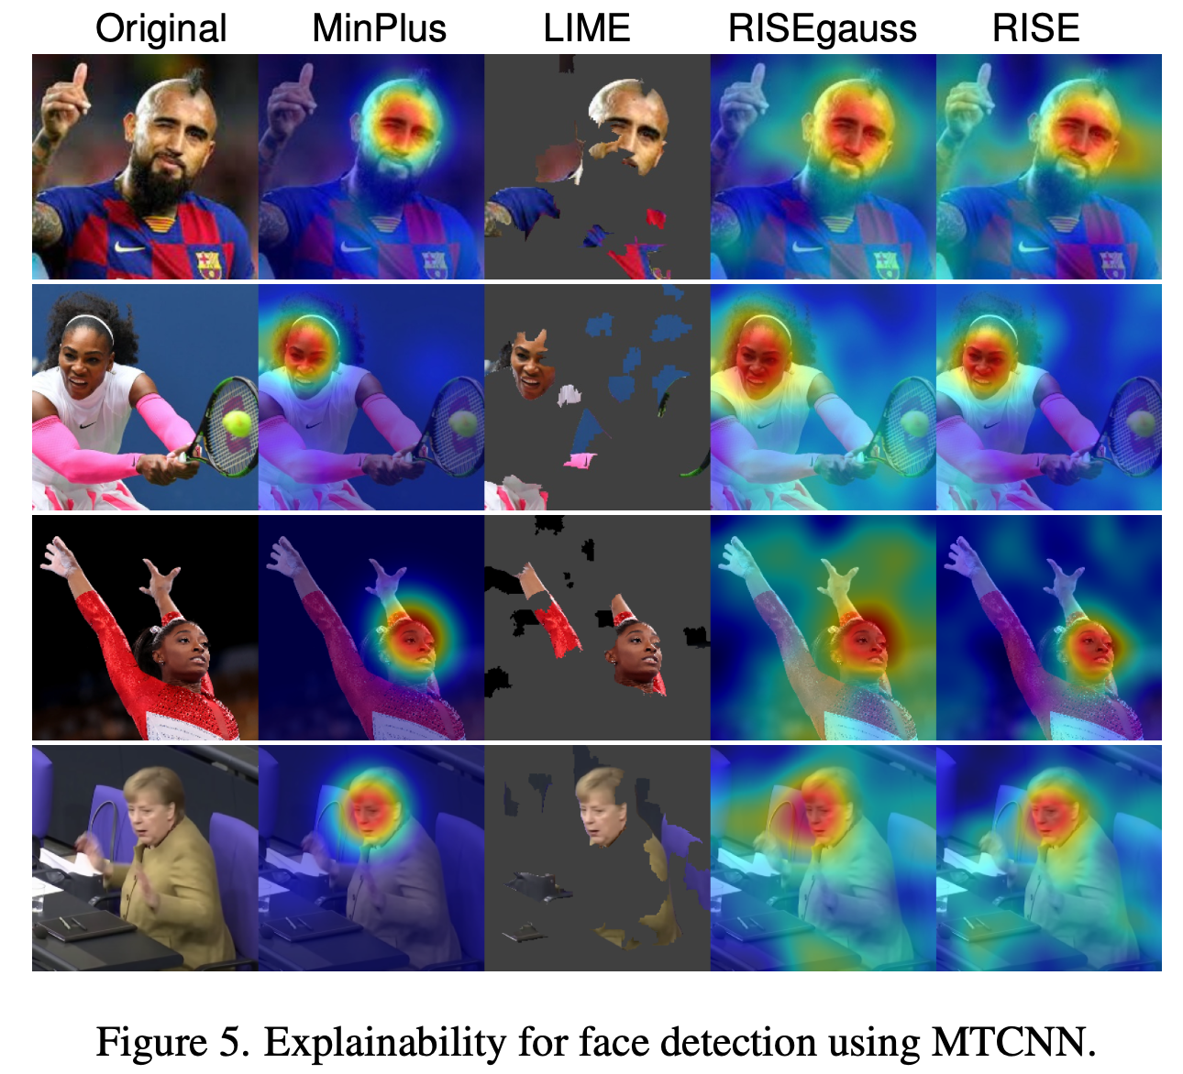
Saliency Maps for face detection using MTCNN

Slide 45
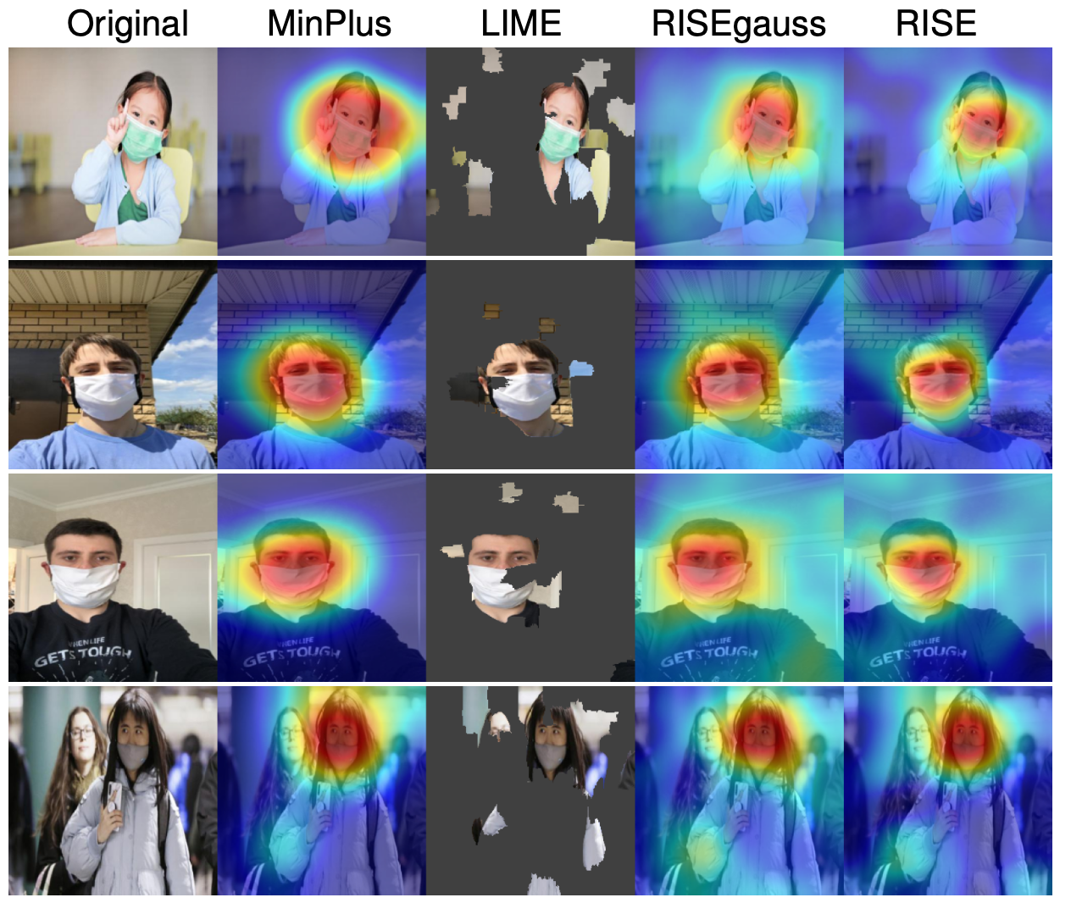
Saliency Maps for face detection with masks using YOLOv5s

Slide 46
4. Conclusions
3. Experiments
2. Method
1. Motivation

Slide 47
Conclusions
We propose MinPlus approach to build a saliency map avoiding any manipulation inside the facial analysis model.
Our method removes and aggregates relevant parts of the face, and measure individual contributions of these parts and in collaboration as well.
MinPlus achieves saliency maps that are stable, very focused and interpretable to humans.
Our approach can be used to evaluate commercial off-the-shelf facial analysis systems as well.

Slide 48
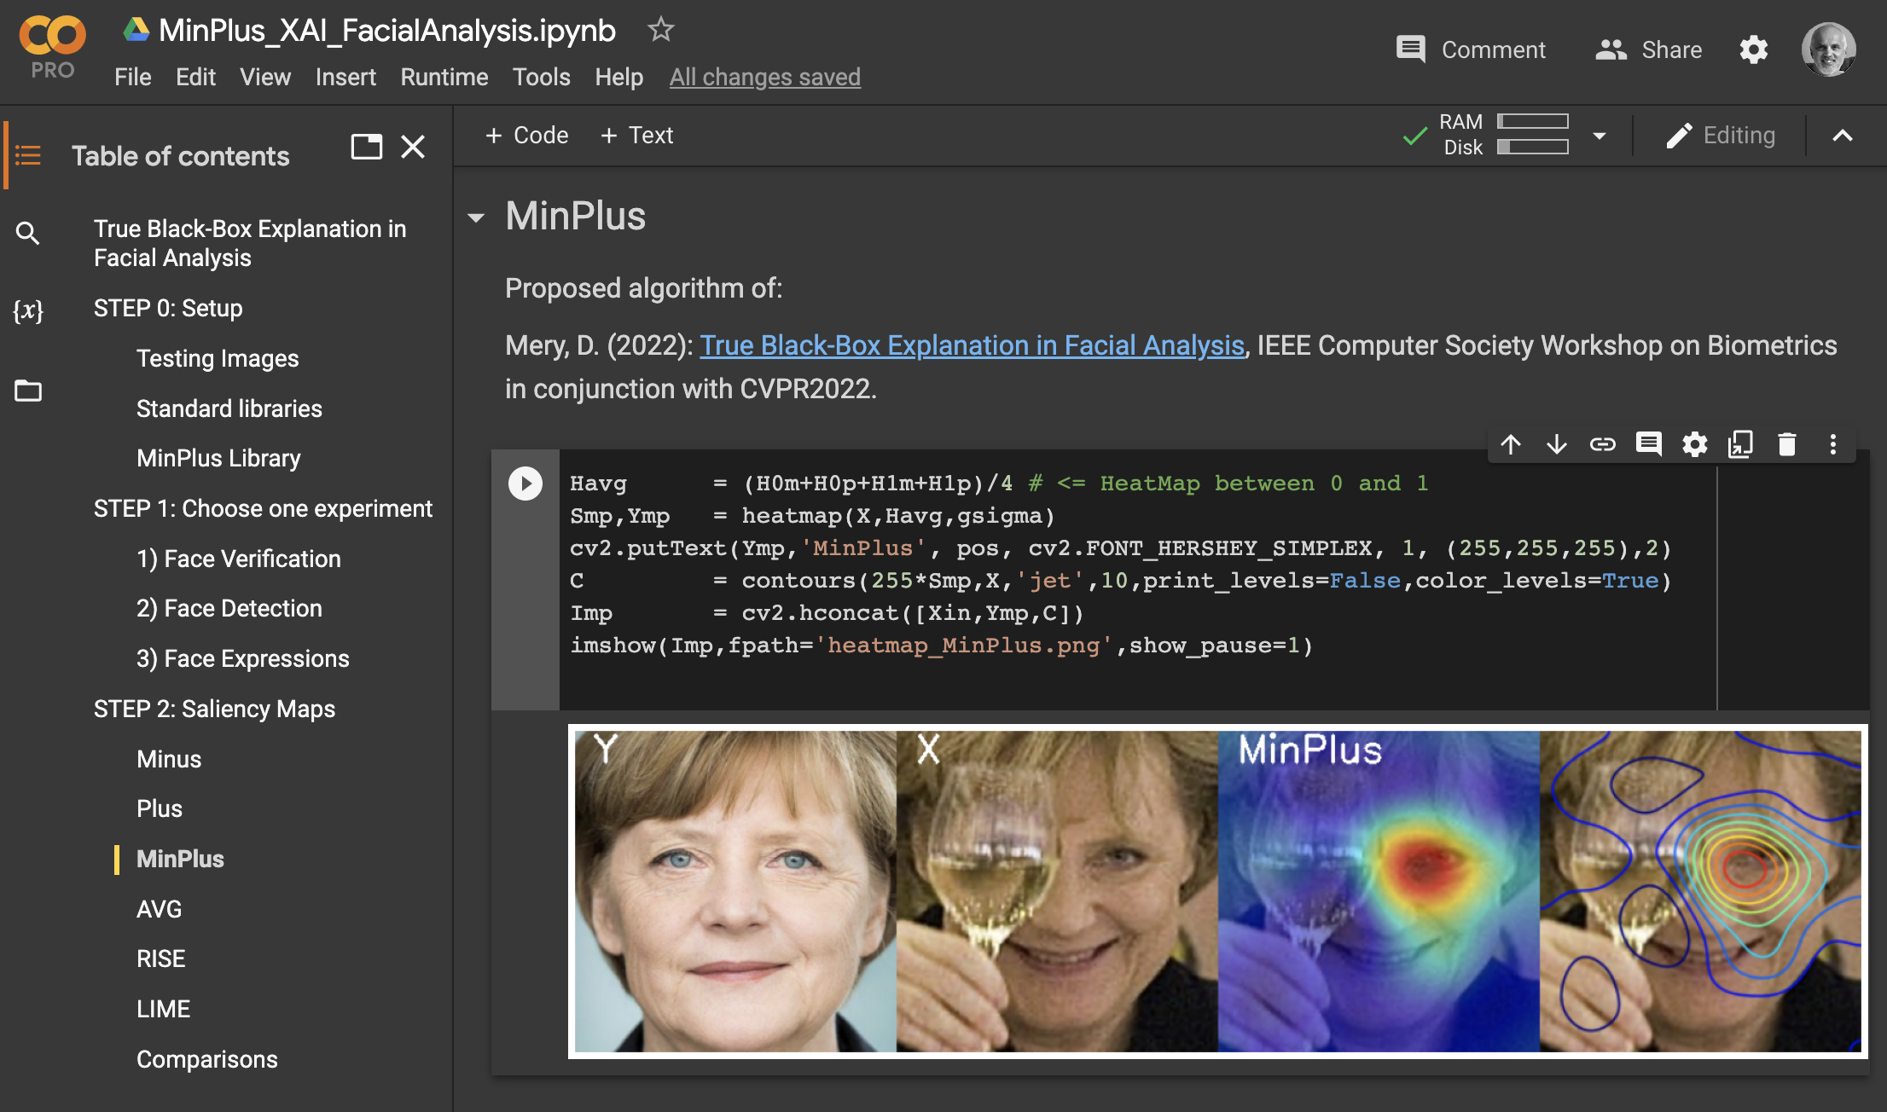

Google Colab:
https://domingomery.ing.puc.cl/material/
bit.ly/3QuJ4A2

Slide 49
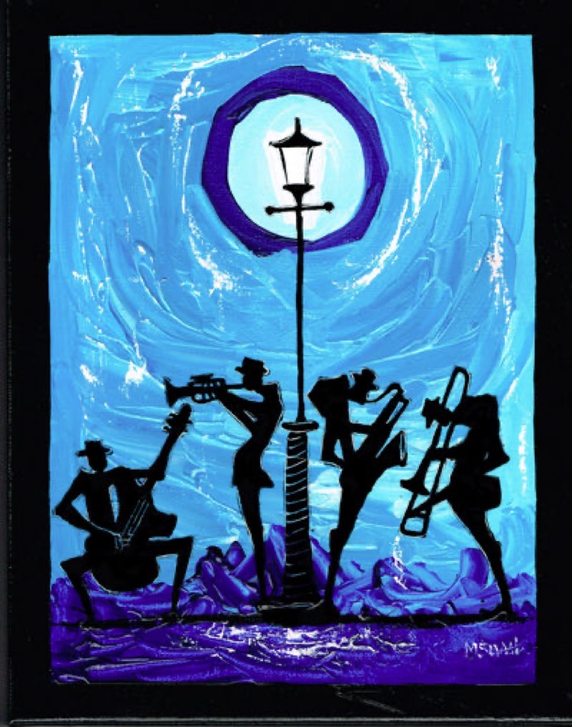
True Black-Box Explanation in Facial Analysis
CVPR 2022 Biometrics Workshop
New Orleans, June 19, 2022
Domingo Mery
Department of Computer Science
Universidad Católica – Chile
http://domingomery.ing.uc.cl

Slide 50
True Black-Box Explanation in Facial Analysis
CVPR 2022 Biometrics Workshop
New Orleans, June 19, 2022
Domingo Mery
National Center for Artificial Intelligence in Chile
Department of Computer Science
Universidad Católica – Chile
http://www.cenia.cl

Slide 51
True Black-Box Explanation in Facial Analysis
CVPR 2022 Biometrics Workshop
New Orleans, June 19, 2022
Domingo Mery
Department of Computer Science
Universidad Católica – Chile
http://domingomery.ing.uc.cl

Slide 53
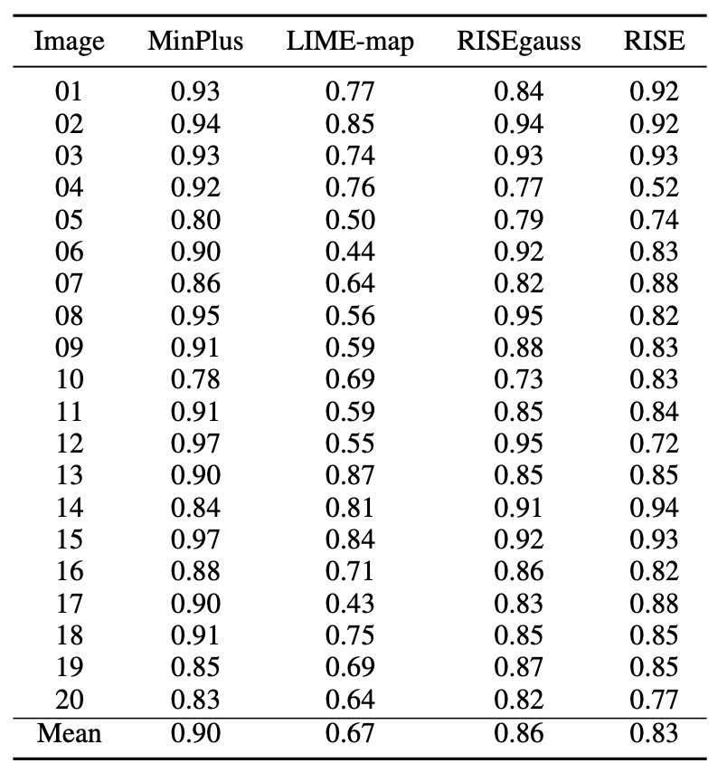
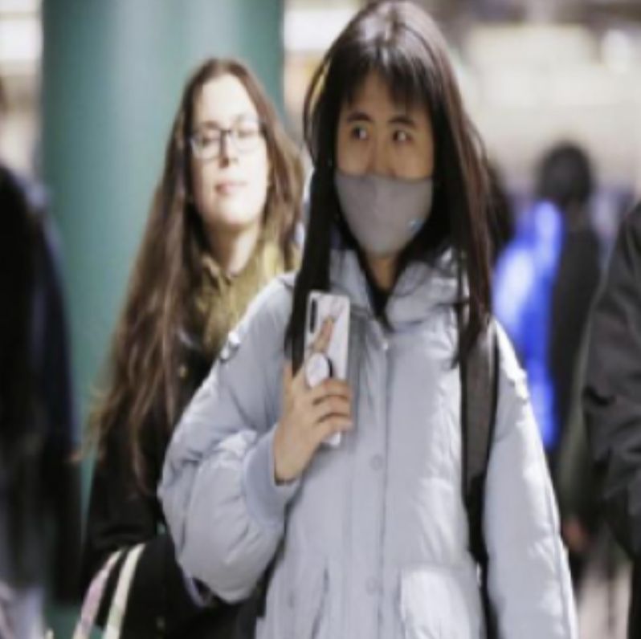

Bounding box
False Negative
Thresholded
Saliency Map
False Positive
True Positive

Slide 54
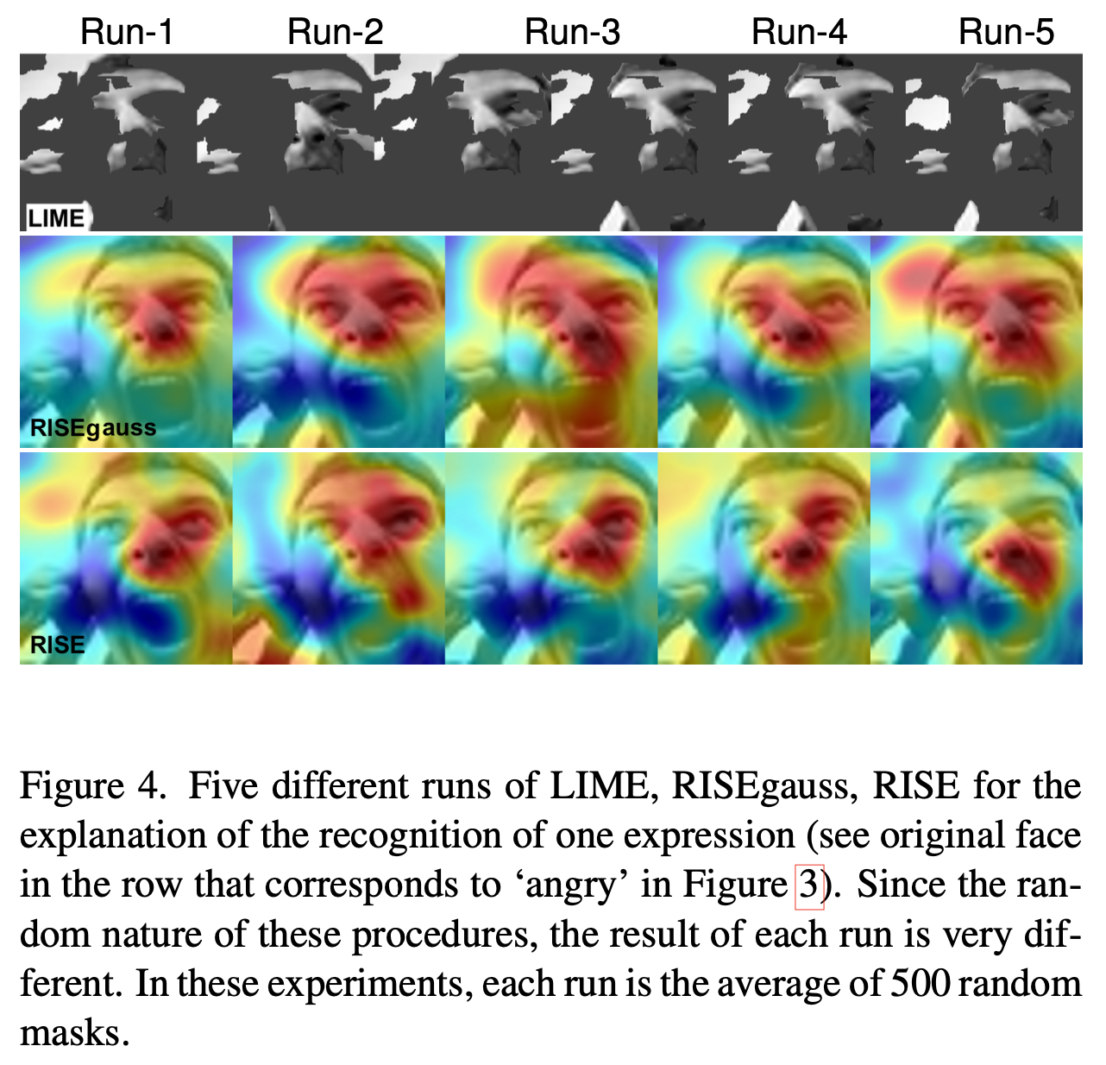

Slide 55
Face Verification
EMBEDDING
PROBE IMAGE
EMBEDDING
GALLERY IMAGE
SCORE
DOT PRODUCT
(cosine distance)

Slide 56
Face Verification
EMBEDDING
PROBE IMAGE
EMBEDDING
GALLERY IMAGE
= 0.8724
SCORE
DOT PRODUCT
(cosine distance)

Slide 57
Face Expression (Attribute)
SCORE
ATTRIBUTE
FUNCTION
ATTRIBUTE
NUMBER

Slide 58
Face Expression (Attribute)
4
= 0.9723
SCORE
ATTRIBUTE
FUNCTION
ATTRIBUTE
NUMBER
angry | 0.0001
disgust | 0.0000
scared | 0.0005
happy | 0.9723
sad | 0.0026
surprised | 0.0001
neutral | 0.0245
SCORE = FOURTH ATTRIBUTE

Slide 59
Detection
NUMBER OF THE
DETECTED OBJECT
SCORE
SCORE
LIST OF
DETECTED OBJECTS
FOR EACH DETECTED OBJECT:

Slide 60
Detection
NUMBER OF THE
DETECTED OBJECT
2
SCORE
= 0.7248
SCORE
LIST OF
DETECTED OBJECTS
FOR EACH DETECTED OBJECT:
1
2

